Slide 1
Weed control
Sarah Cook and Denise Ginsburg

Slide 2
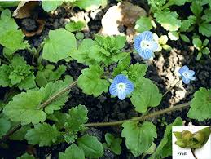
Early nectar for bees

Slide 3
Weeds and disease
Volunteer potato
Blight, eelworm

Slide 4
Competition

Slide 5
The garden year
Jun
Jul
Aug
May
Sowing
Plant out
Apr
Sep
Harvest
Oct
Mar
Preparation
Feb
Nov
Jan
Dec

Slide 6
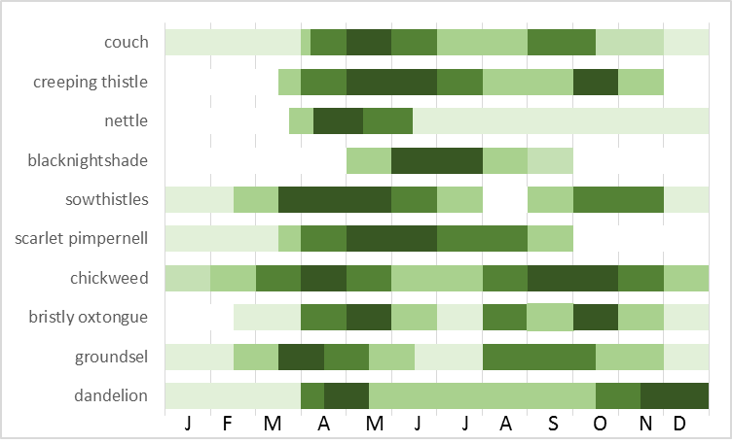
Major weeds - germination

Slide 7
Where do weeds come from?
Creepers / spreaders -
Buttercup
Couch/scutch/twitch
Mares tail
Blowers -
Sowthistle
Dandelion
willow
Seed germinates from top 5cm
Lurkers -
Poppy
Cotton thistle
Poppers -
bittercress
Himalayan balsam
Poopers-
tomato
nightshade
Clingers-
Cleavers
burdock
The seedbank

Slide 8
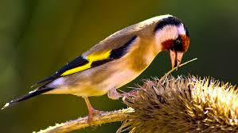
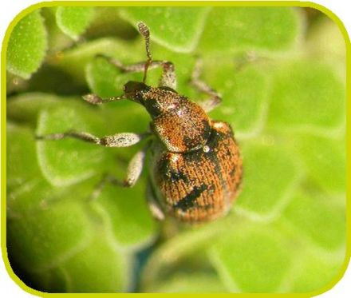
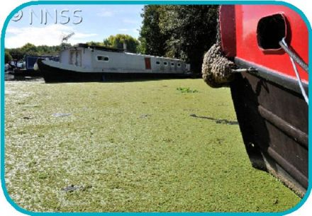
Natural predators
Beetles and fungi – target seeds, maintain a good soil biota
Birds – eat seeds and leaves
Rabbits – tend not to eat the weeds
Humans
Stenopelmus rufinasus
Azolla

Slide 9
Annual weeds
Live and flower in a year
Grasses and broad-leaved weeds
Control the seeds

Slide 10
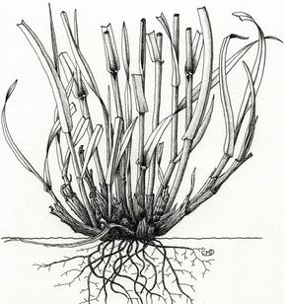
Grasses dig out below tillering area or cut off with knife

Slide 11
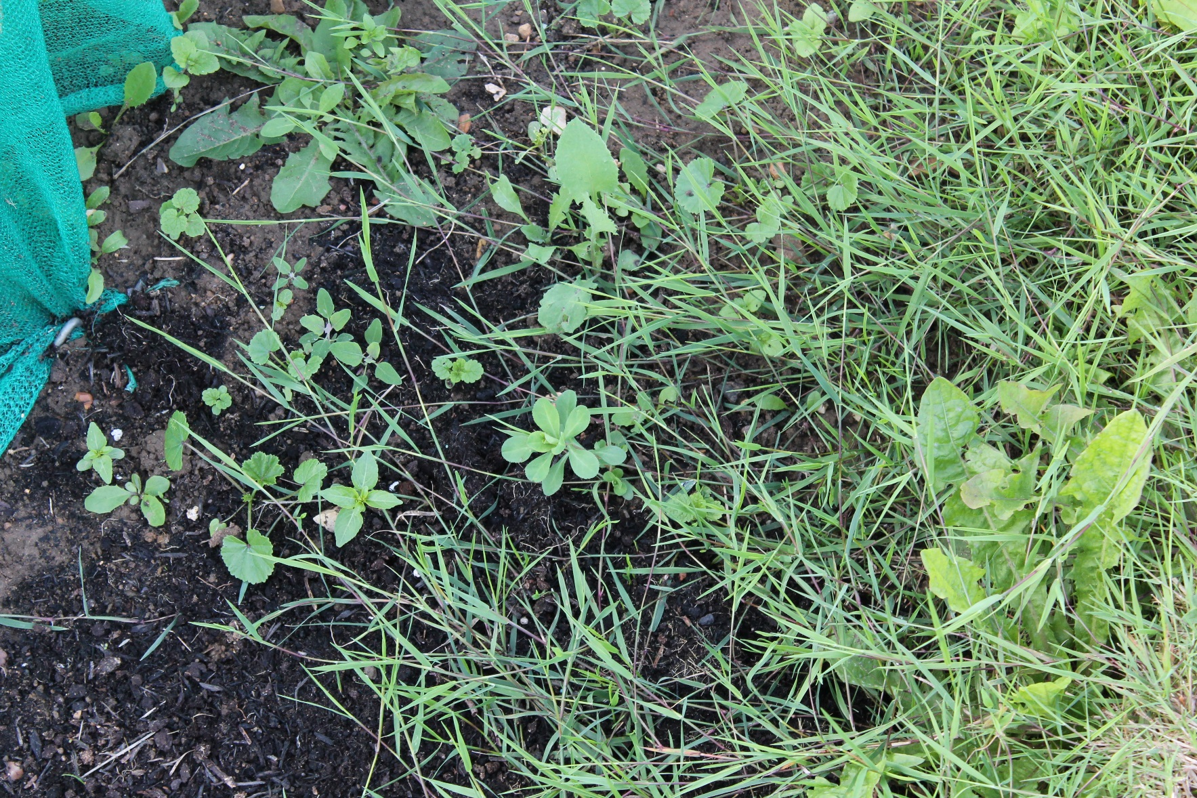
Creeping Bent

Slide 12
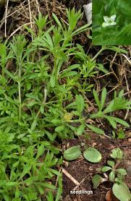
Cleavers
Fine lower stem breaks easily
Shoots from top of root plate
Make sure you pull up growing point
Rake them out when large to reduce seed return
Easy to reduce populations quickly

Slide 13
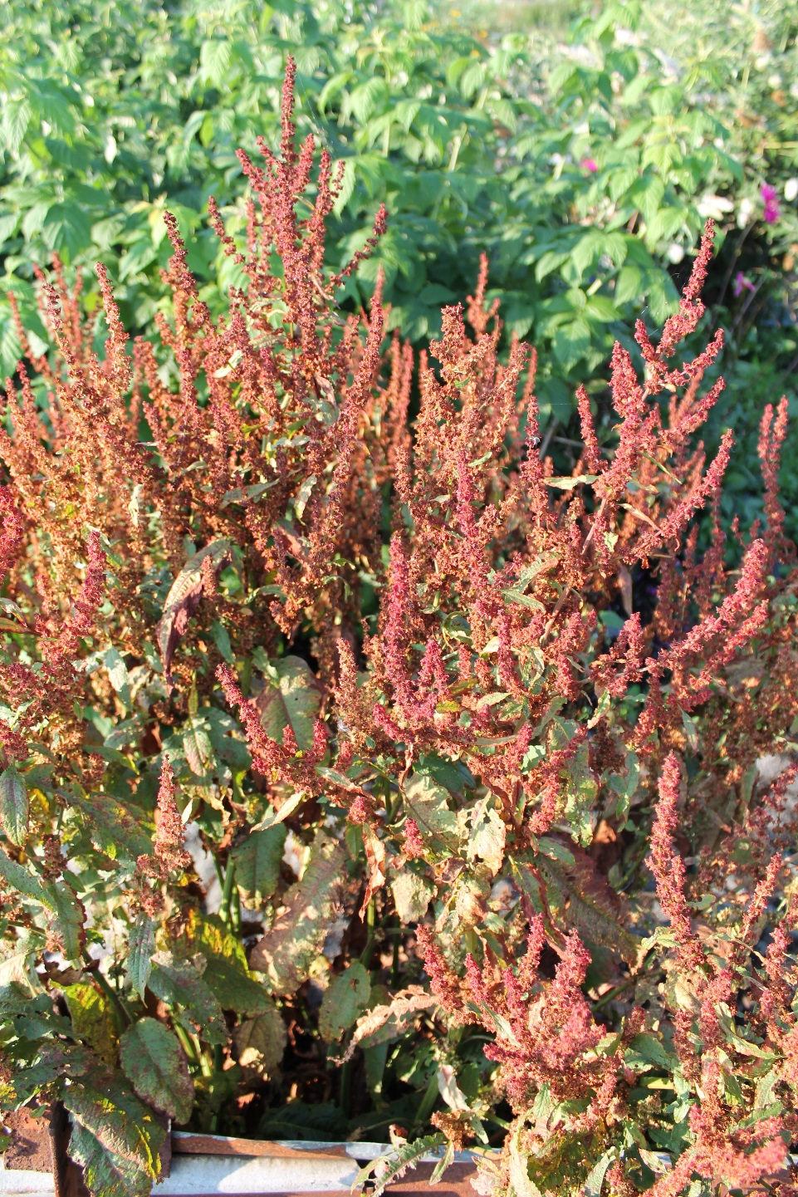
Cleavers
Docks

Slide 14
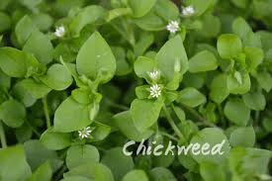
Chickweed
Germinates continuously
Roots from the nodes so difficult to pull out
Loves nutrient rich soils
Seeds prolifically from a young age.
Edible

Slide 15
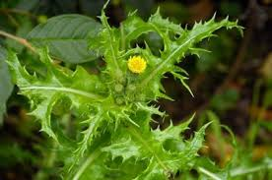
Sowthistle (annual)
Comes as prickly or smooth species.
Usually blows in on the wind, so prevent this happening
Enjoyed by guinea pigs, rabbits and tortoises
Tends to germinate later in the season and grows rapidly
Pull out the tap root

Slide 16
Biennial weeds
Biennial weeds, overwinter as small plants flower next year,
chance to kill small plants in early spring,
stop it seeding next year.

Slide 17
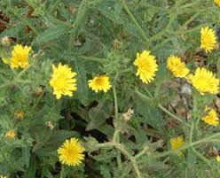
Bristly oxtongue
Biennial
Short term perennial
Kill seedlings
Dig out mature plants

Slide 18
Perennial weeds
Perennials live for many years,
Remove young seedlings
Old plants, dig out roots, as deep as possible
Don’t let them flower to stop them seeding
Best chance of control: Remove young seedlings.

Slide 19
How perennial weeds survive
Summer
Shoots make food and energy
Roots grow
Food stored in roots
Autumn
Energy from dying shoots stored in roots
Winter
Food not depleted as temperature decreases
Spring
Food reserves used to grow new shoots

Slide 20
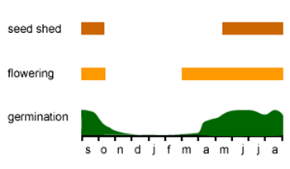
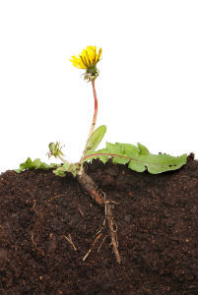
Dandelion
Tap root
Regenerates from large root fragments at top of root.
Control
At least remove shooting area of root
Shooting area

Slide 21
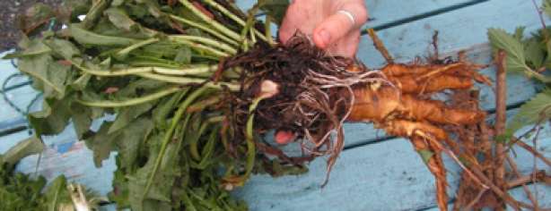
Dock
Top part underground stem
Bottom part underground root
Old plants have lateral shoots and lateral roots
Broken fragments of underground roots regenerate
Control
Remove root to below transition area
Transitional areas

Slide 22
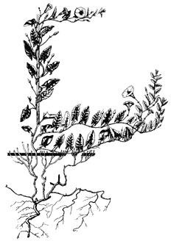
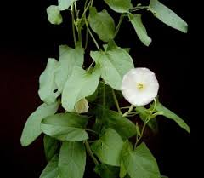
Field bindweed
Roots can't be dug out
Pull or dig out rhizome as deep as possible
More than one shoot may regenerate
Control
Repeated hoeing can kill the plant. Optimum interval 12 days.
Paint rosettes with glyphosate

Slide 23
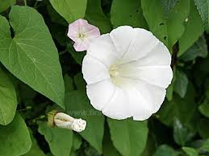
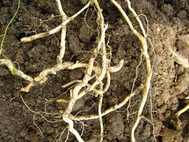
Hedge bindweed
Much bigger form of field bindweed
Flowers 2-3 inches and white
Grows up hedges
Has thick white roots that are easy to dig out but very brittle

